Slide 1
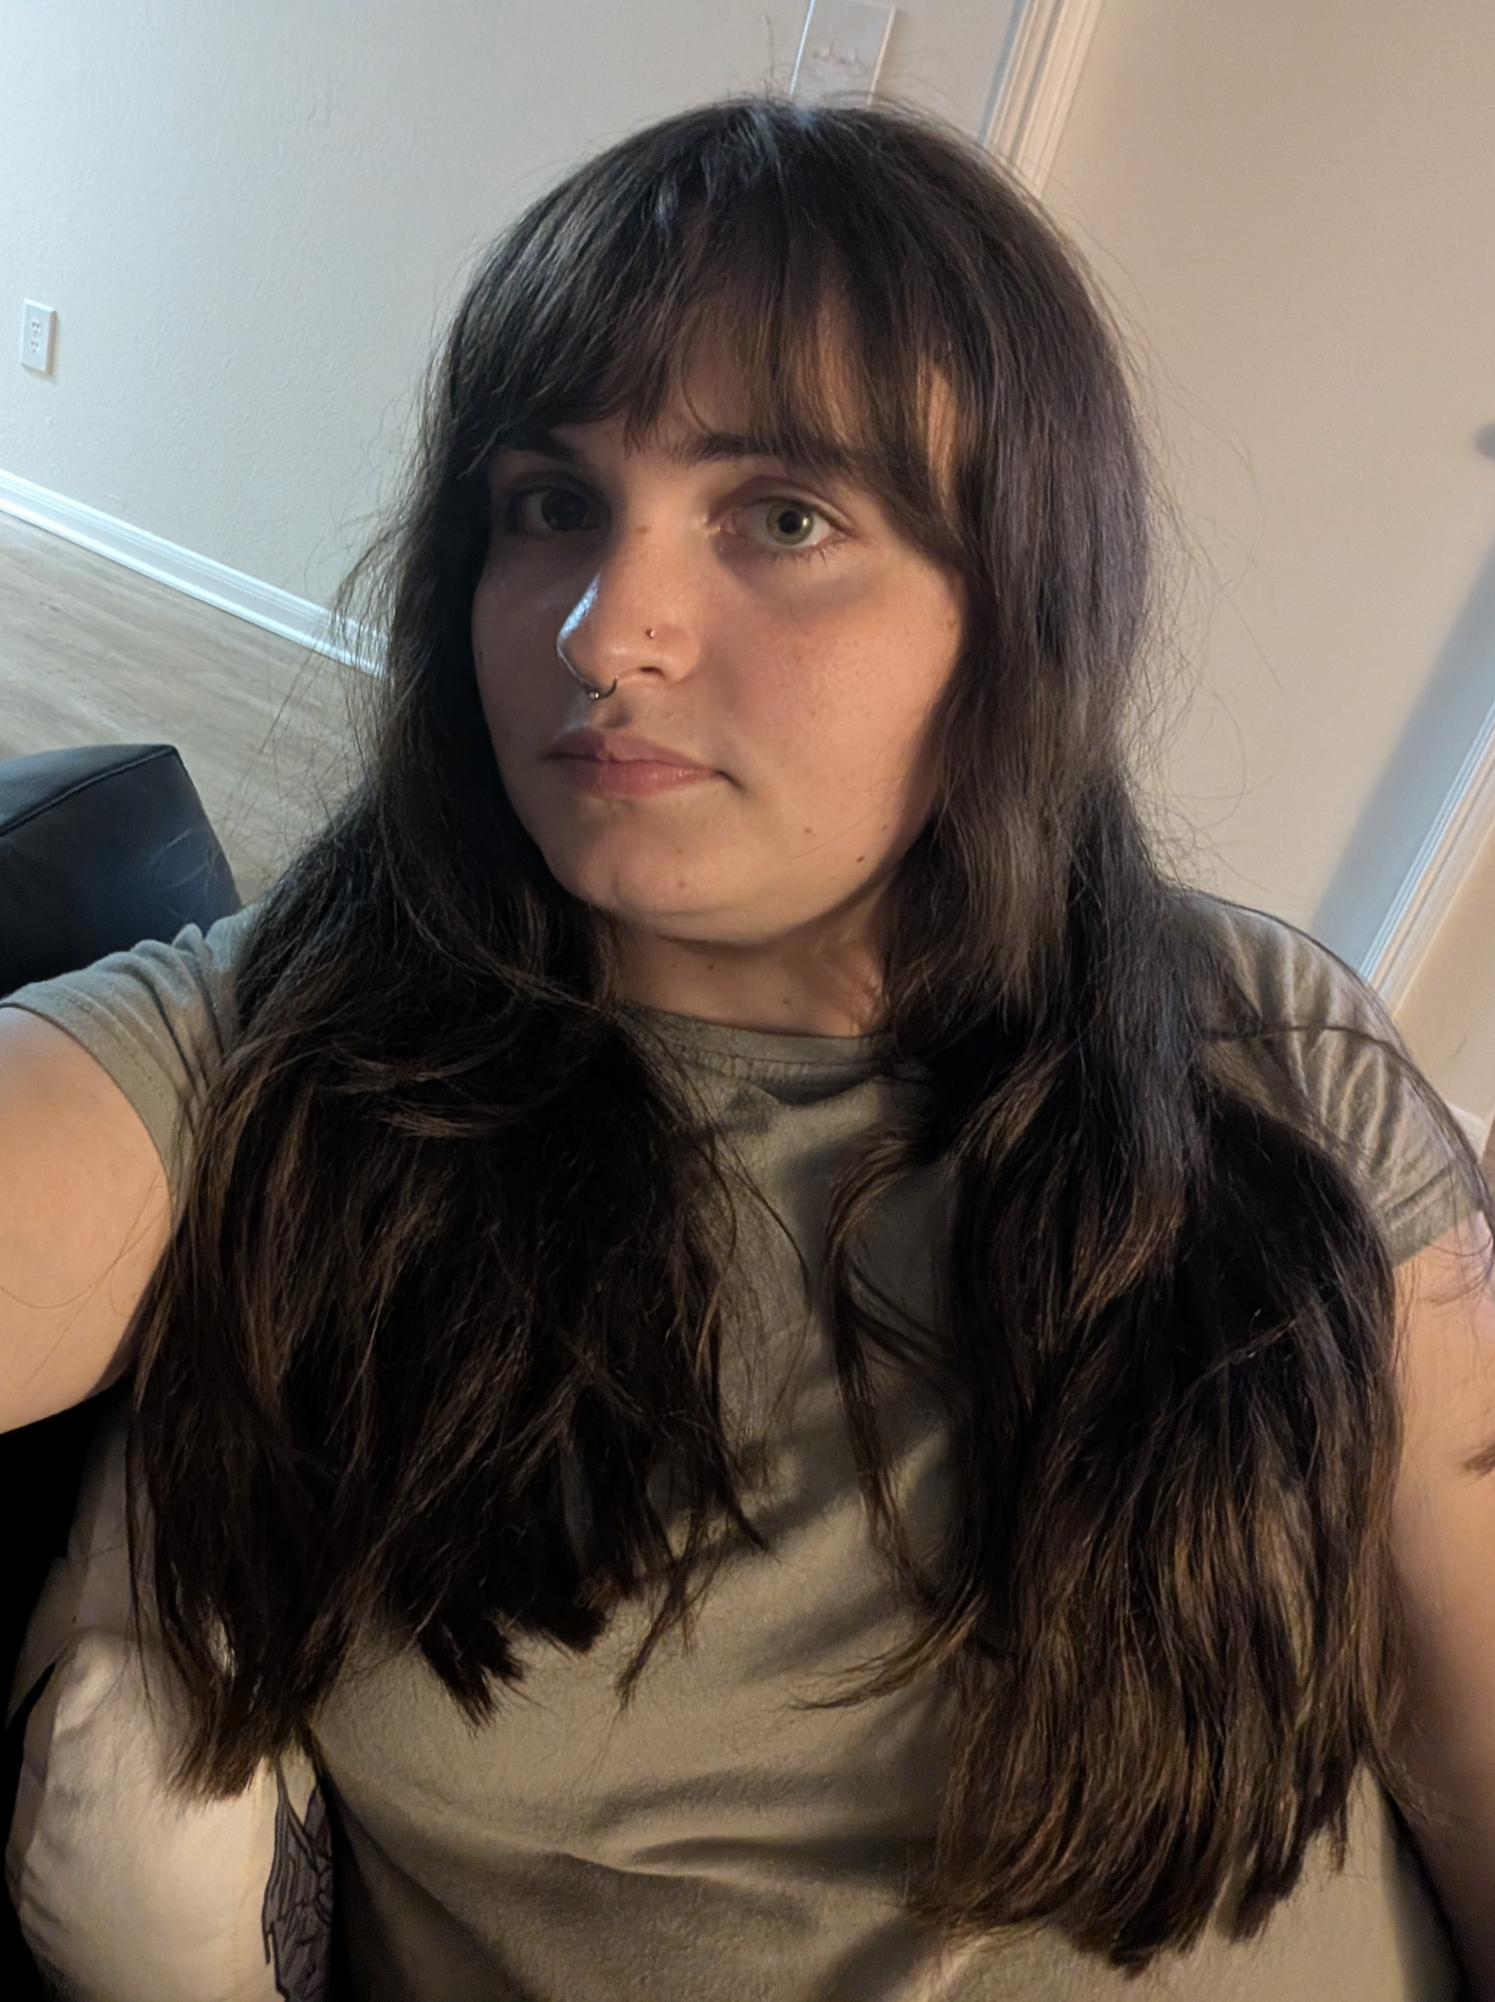
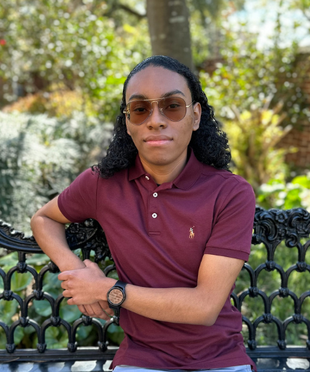
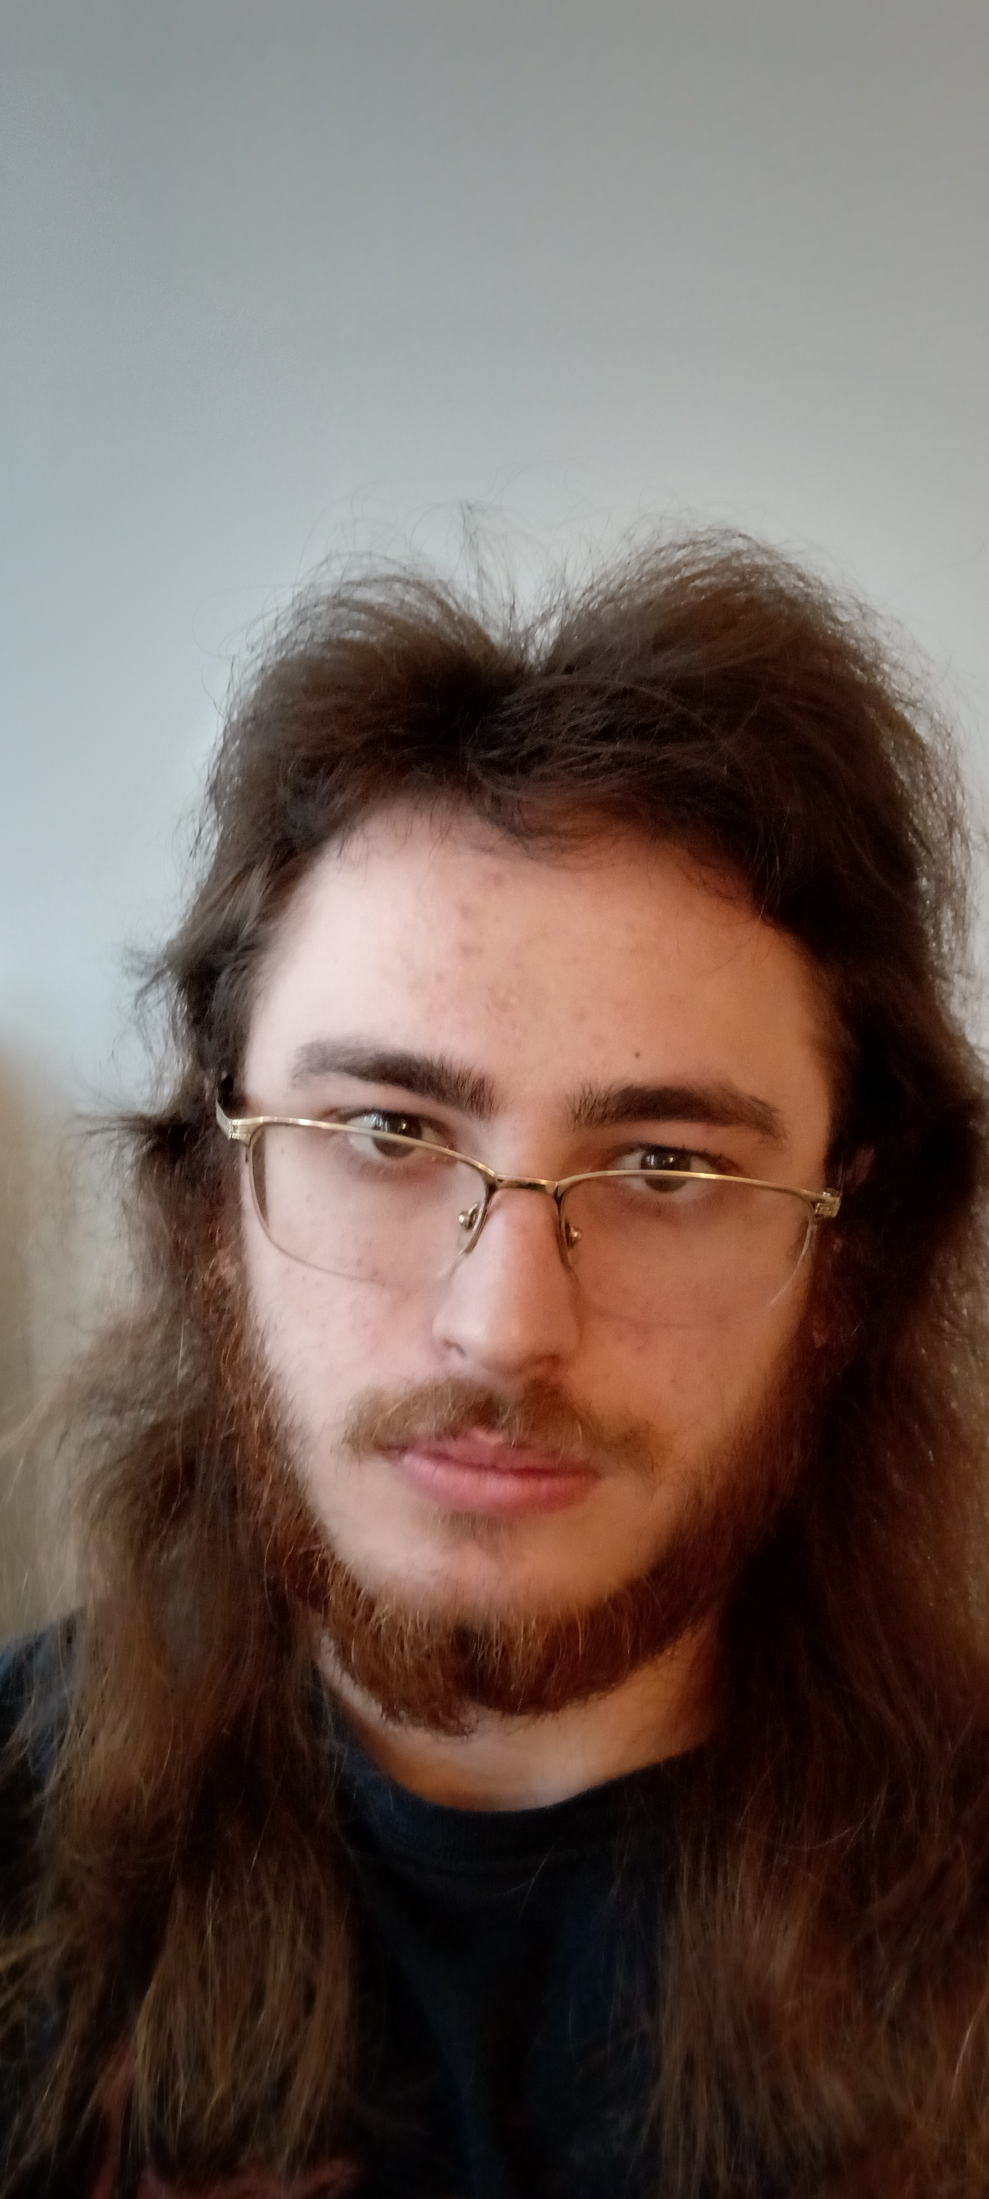
Optimizing Facial Recognition Models to Improve Power and Speed Efficiency
Alphanso Davis-Moses
Simion Cartis
Mabel Hurd
Supply Chain and Data Analytics
Business Perspective
Computer Science
Developer
Computer Science
Developer, Research
Our diverse backgrounds allow us to approach the problem from different angles and build a more comprehensive solution.
Weekly Friday check-ins • Shared GitHub • Continuous communication
Notes:
Title, members, why we teamed up and synergy. “Focusing on how our technical work translates into practical value and real-world applications.”

Slide 2
Problem
Facial recognition algorithms need to both identify if a face is valid and if it is a person's actual face as opposed to a picture of a face. Moreover, they need to do this quickly, efficiently, and accurately.
As facial recognition becomes the standard authentication method for every-day devices, it is important that these models are both convenient and accurate
Central question: are we able to quantize facial recognition models down from fp32 to int8 for battery/speed optimization while maintaining accuracy?
Notes:
What is the problem, why is it interesting to us, project type (replications/extension)

Slide 3
Solution
We will test whether INT8 quantization enables faster, lower-power facial authentication on a Raspberry Pi while keeping acceptable accuracy and security.
EXISTING MODELS
NEW TOOL
Liveness Detection
Identity Verification
Raspberry Pi Prototype
Silent-Face-Anti-Spoofing
Real person or photo / screen replay?
InsightFace
Does the live face match the enrolled user?
Webcam input
Liveness + Identity Verification
Two separate security checks
Automatically accepts or rejects the attempt
CONTROLLED FP32 VS. INT8 STUDY
Original FP32
INT8 Version
VS.
Full-precision models
Quantized versions of the same models
Compare: Latency, Memory, Energy Use, FAR/FRR/EER, etc.
Notes:
FAR = False Acceptance Rate (Identity Verification)
FRR = False Rejection Rate (Identity Verification)
Equal Error Rate

Slide 4
Evaluation
Quantitative Metrics:
  Speed: Measure median (p50) and 95th percentile (p95) end-to-end inference latency, covering face detection, alignment, and feature vector extraction directly on the target hardware.
  Efficiency: Monitor active device power draw, runtime memory consumption (Resident Set Size), and total model binary footprint on disk across precision formats.
  Quality: Evaluate biometric verification and identification using the core industry accuracy metrics: False Match Rate (FMR / FAR), False Non-Match Rate (FNMR / FRR), Equal Error Rate (EER), and True Accept Rate at a fixed False Accept Rate (such as TAR at FAR = 0.1%).
Qualitative Visualizations:
  ROC & DET Curves: Plot Receiver Operating Characteristic (ROC) and Detection Error Tradeoff (DET) curves to map the operational trade-off between false matches and false rejections across different threshold settings.
  Pareto Frontier & Disparity Plots: Generate Pareto frontier scatterplots (Accuracy vs. Latency) to identify optimal deployment targets, and plot subgroup degradation curves across skin tone, gender, and lighting variations to evaluate Trustworthy AI fairness.
Baseline Comparisons:
  Quantization Impact: Compare all INT8 and FP16 quantized models directly against uncompressed full-precision (FP32) baseline weights to detect where any accuracy drop-offs occur.
  Runtime Acceleration: Compare default framework inference against hardware-optimized runtime engines (such as ONNX Runtime with ARM NEON execution or TFLite with XNNPACK) to isolate hardware-level speedups.
Notes:
Qualitatively (what kind of results/plots and figures), quantitatively: what kind of analysis (performance metrics/statistical tests), are we comparing it to existing solutions

Slide 5
?
Thank you
Questions?
Quantized face authentication on Raspberry Pi

